Slide 1
Hotel Booking Cancellation Prediction
Decision Systems

Slide 2
Contents / Agenda
Data Dictionary
Business Problem Overview and Solution Approach
EDA Results
Data Preprocessing
Model Performance Summary
Conclusions and Recommendations
Appendix

Slide 3
Data Dictionary
The data contains the different attributes of customers' booking details. The detailed data dictionary is given below:
Booking_ID: the unique identifier of each booking
no_of_adults: Number of adults
no_of_children: Number of Children
no_of_weekend_nights: Number of weekend nights (Saturday or Sunday) the guest stayed or booked to stay at the hotel
no_of_week_nights: Number of weeknights (Monday to Friday) the guest stayed or booked to stay at the hotel
required_car_parking_space: Does the customer require a car parking space? (0 - No, 1- Yes)
room_type_reserved: Type of room reserved by the customer. The values are ciphered (encoded) by INN Hotels Group

Slide 4
Data Dictionary
lead_time: Number of days between the date of booking and the arrival date
arrival_year: Year of arrival date
arrival_month: Month of arrival date
arrival_date: Date of the month
market_segment_type: Market segment designation.
repeated_guest: Is the customer a repeated guest? (0 - No, 1- Yes)
no_of_previous_cancellations: Number of previous bookings that were canceled by the customer prior to the current booking
no_of_previous_bookings_not_canceled: Number of previous bookings not canceled by the customer prior to the current booking

Slide 5
How to use this deck?
This slide deck serves as a comprehensive template for your project submission
Within this deck, you will come across various questions that are intended to test your ability to understand data visualizations, discover patterns / insights and postulate hypothesis. Think thoroughly and provide answers to these questions
You are encouraged to modify this deck as required, by replacing the questions with suitable answers
Please feel free to incorporate additional points if you deem necessary
Note: The data visualizations you see in this deck are obtained from RapidMiner

Slide 6
Business Problem Overview and Solution Approach
Please define the problem
Please mention the solution approach / methodology

Slide 7
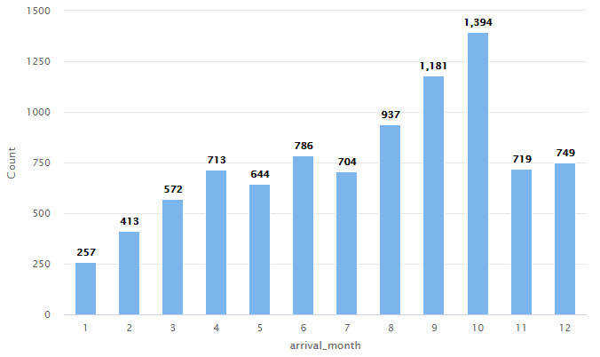
EDA - Univariate Analysis
Explore strategies to effectively manage and accommodate the increased demand
X-axis: Arrival month
Y-axis: Number of bookings
Description: Number of bookings per month

Slide 8
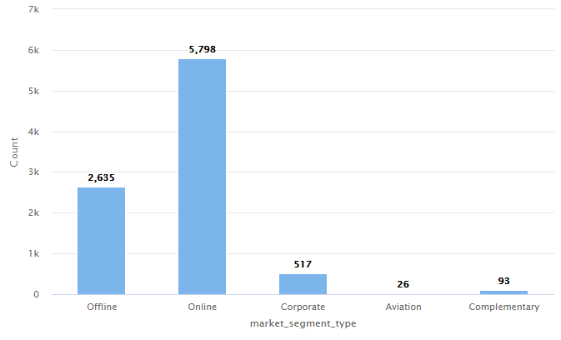
EDA - Univariate Analysis
Identify the percentage of bookings made online versus offline and highlight any trends or insights that can inform business strategies.
X-axis: Market Segment Type
Y-axis: Number of customers
Description: Number of Bookings received in each market segment

Slide 9
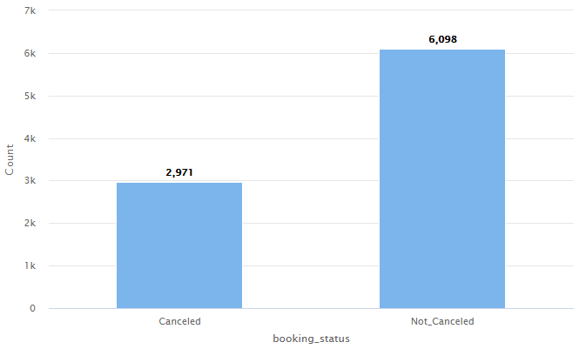
EDA - Univariate Analysis
Analyze the percentage of bookings that are cancelled. Are the cancellation trends a serious issue that needs to be looked at? If so, what potential solutions can be implemented to address this problem?
X-axis: Booking status
Y-axis: Number of bookings
Description: Count of bookings that are Cancelled v/s Not Cancelled

Slide 10
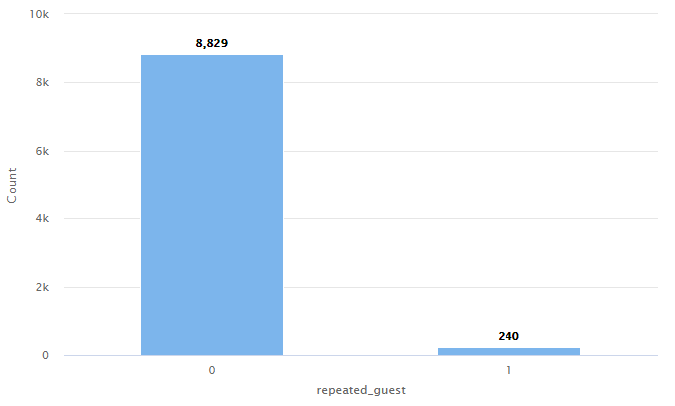
EDA - Univariate Analysis
To what extent are customers returning to the hotel? Is this indication considered positive or negative, and what factors may be influencing this behavior? Furthermore, what strategies can be implemented to address and potentially improve this situation?
X-axis: Repeated guests
Y-axis: Number of Guests
Description: Customers who have visited the hotel more than once vs customers who have visited the hotel only once

Slide 11
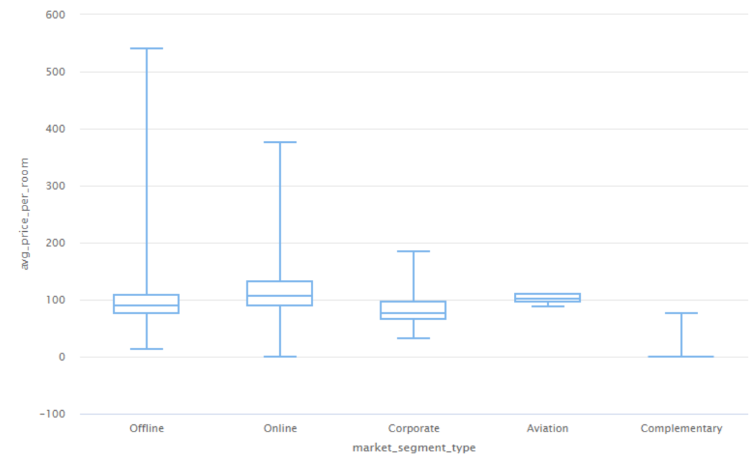
EDA - Univariate Analysis
Explore how hotels can optimize their revenue management strategies considering the significant price variations observed across different market segments
X-axis: Market segment type
Y-axis: Average price per room
Description: Price per room across various market segments

Slide 12
Results EDA - Univariate Analysis
Provide a concise overview of the discoveries derived from the Univariate Analysis.

Slide 13
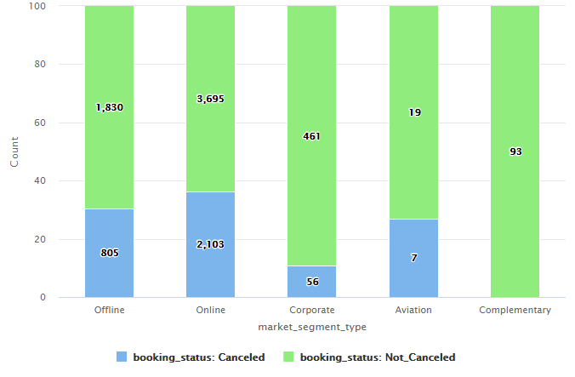
EDA - Bivariate Analysis
Explore strategies to mitigate cancellations and consider how these insights can be leveraged to reduce cancellations across different booking channels
X-axis: Market Segment type
Y-axis: Number of customers
Description: Number of booking that are cancelled vs not cancelled across various market segments

Slide 14
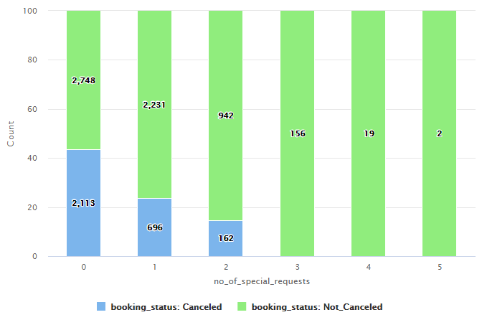
EDA - Bivariate Analysis
Examine the influence of special requests on booking cancellations and devise effective strategies to mitigate cancellation rates when customers make such requests.

Slide 15
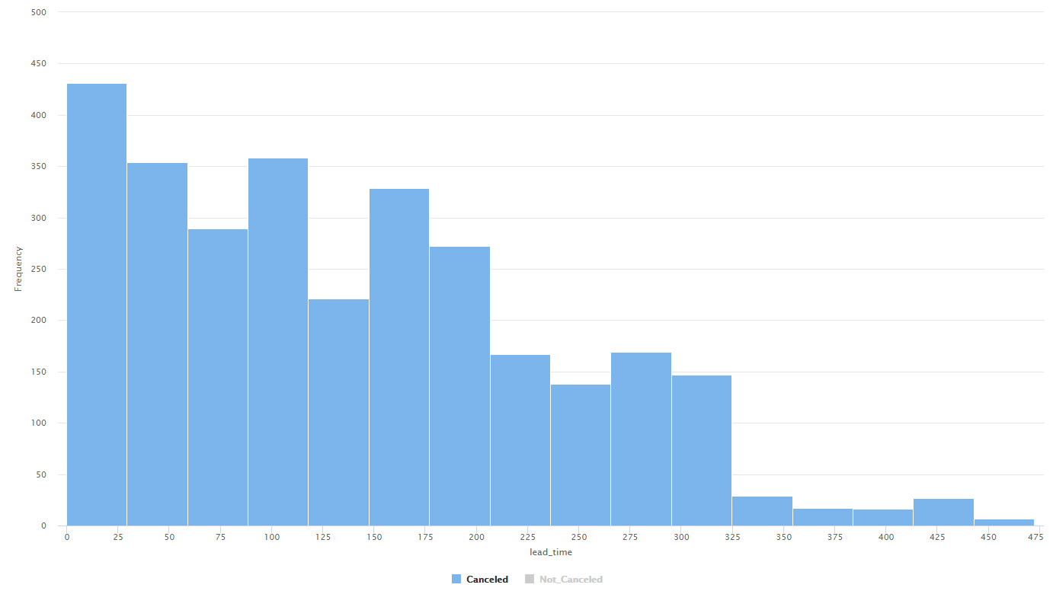
EDA - Bivariate Analysis
What insights can be gained from the lead time of canceled bookings, and how can we leverage this information to improve our booking system and enhance customer satisfaction?
X-axis: Lead time
Y-axis: Number of bookings
Description: Lead time of the bookings that were cancelled

Slide 16
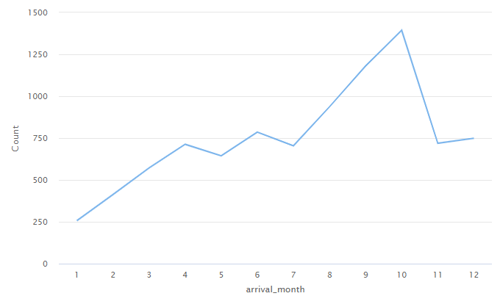
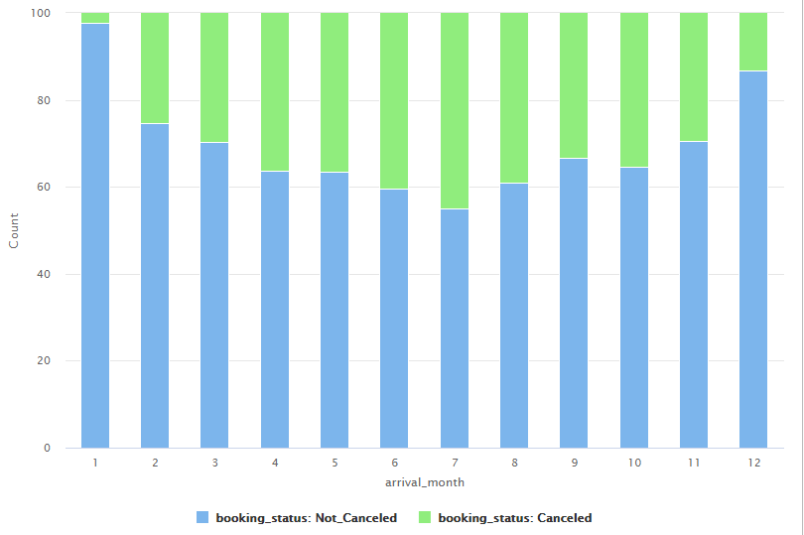
EDA - Bivariate Analysis
Analyze the cancellation rate for each month and compare it to other months to determine any patterns or reasons for variation.

Slide 17
Results EDA - Bivariate Analysis
Provide a concise overview of the discoveries derived from the Bivariate Analysis.

Slide 18
Model Performance Evaluation Decision Tree
Please comment on the model performance of the Decision Tree Model
Model | Train Accuracy | Test Accuracy | Train Recall | Test Recall | Train Precision | Test Precision
Decision Tree | 99.65 | 83.20 | 99.47 | 76.77 | 99.47 | 73.23

Slide 19
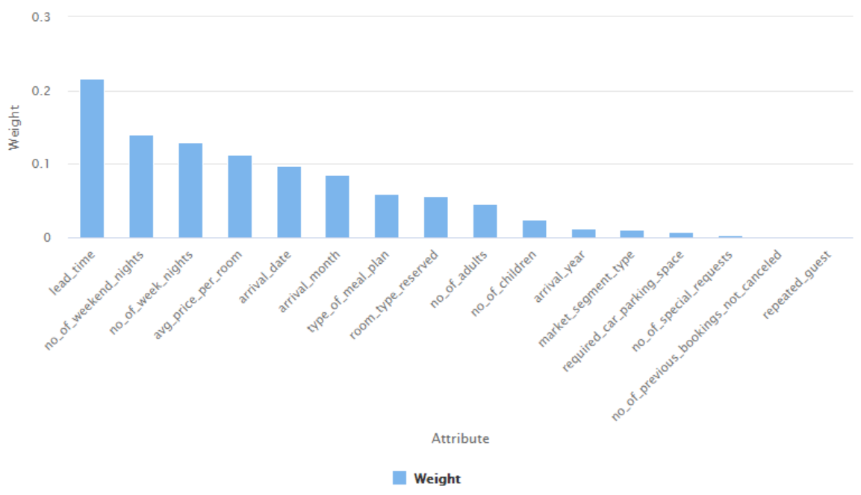
Model Performance Evaluation Decision Tree
To what extent and in what ways have the attribute weights influenced the overall performance of the model?

Slide 20
Model Performance Evaluation Pruned Decision Tree
Based on the evaluation metrics obtained from a pruned decision tree, do you perceive any notable enhancements in performance? What factors do you believe contributed to this improved performance compared to the previous version?
Model | Train Accuracy | Test Accuracy | Train Recall | Test Recall | Train Precision | Test Precision
Decision Tree | 99.65 | 83.20 | 99.47 | 76.77 | 99.47 | 73.23
Decision Tree - Pruned | 95.64 | 84.34 | 90.77 | 76.09 | 95.69 | 76.09

Slide 21
Model Performance Evaluation Random Forest
While the Random Forest model demonstrates high accuracy and precision on both the training and test sets, it appears to have a noticeable drop in recall on the test set compared to the training set. What potential factors could contribute to this difference in recall, and how might it impact the model's overall performance and practical applications?
Model | Train Accuracy | Test Accuracy | Train Recall | Test Recall | Train Precision | Test Precision
Random Forest | 98.47 | 87.94 | 96.44 | 77.10 | 98.87 | 84.71

Slide 22
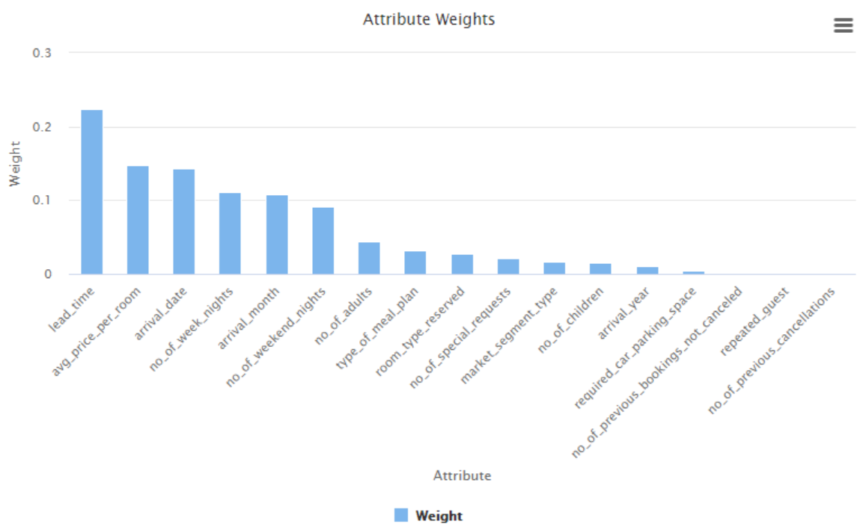
Model Performance Evaluation Random Forest
To what extent and in what ways have the attribute weights influenced the overall performance of the model?

Slide 23
Model Performance Evaluation Pruned Random Forest
Based on the evaluation metrics obtained from a pruned Random Forest, do you perceive any notable enhancements in performance? What factors do you believe contributed to this improved performance compared to the previous version?
Model | Train Accuracy | Test Accuracy | Train Recall | Test Recall | Train Precision | Test Precision
Random Forest | 98.47 | 87.94 | 96.44 | 77.10 | 98.87 | 84.71
Random Forest - Pruned | 87.32 | 85.04 | 69.86 | 66.22 | 89.09 | 84.77

Slide 24
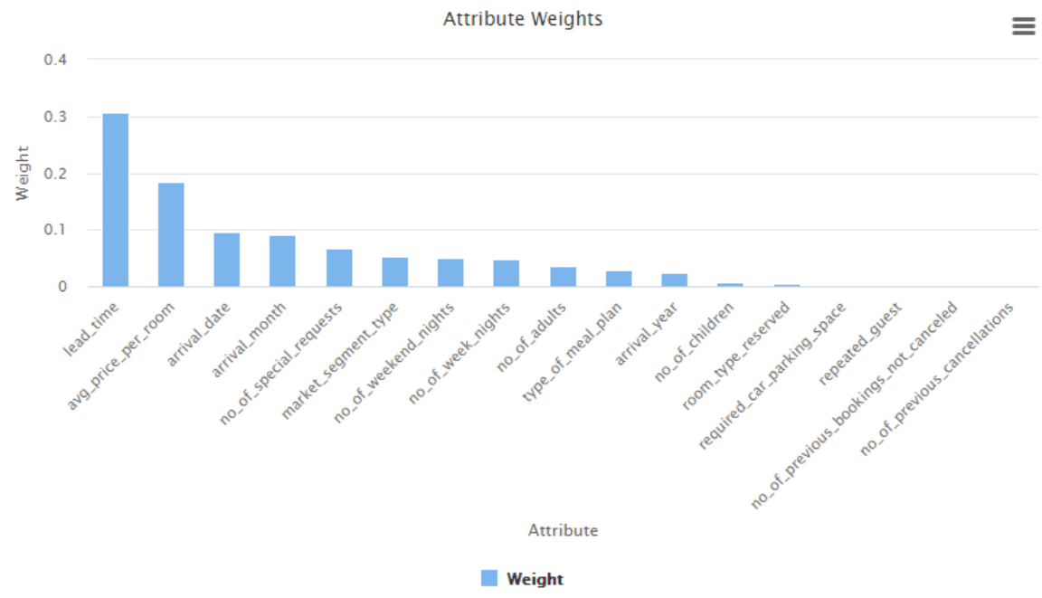
Model Performance Evaluation Pruned Random Forest
To what extent and in what ways have the attribute weights influenced the overall performance of the model?

Slide 25
Model Performance Summary
Description of the ML model that best fits the business objective. Also state which evaluation metric (such as accuracy, recall or precision) is important to achieve the business objective and why?
Synopsis of the key features employed by the ML model to make predictions.
Offer suggestions and advice for the hotel based on the gathered insights.
Model | Train Accuracy | Test Accuracy | Train Recall | Test Recall | Train Precision | Test Precision
Decision Tree | 99.65 | 83.20 | 99.47 | 76.77 | 99.47 | 73.23
Decision Tree - Pruned | 95.64 | 84.34 | 90.77 | 76.09 | 95.69 | 76.09
Random Forest | 98.47 | 87.94 | 96.44 | 77.10 | 98.87 | 84.71
Random Forest - Pruned | 87.32 | 85.04 | 69.86 | 66.22 | 89.09 | 84.77

Slide 26
Conclusions and Recommendations
Please mention actionable insights & recommendations
Below are some useful pointers that can guide you :
  Identify the hotel's target market and booking patterns
  Analyze the booking trends and cancellations over a period of time
  Determine the impact of cancellations on hotel revenue and resources
  Evaluate the consistency of cancellation policies across market segments
  Determine how to improve the experience of repeated customers and attract new ones

Slide 27
APPENDIX

Slide 28
Slide Header
Please add any other pointers (if needed)

